Slide 1


SECRETARY
Rtr.SHIVANI GUPTA
2021-2022

Slide 2

ROLES / DUTIES AND RESPONSIBILITIES OF CLUB SECRETARY

Slide 3
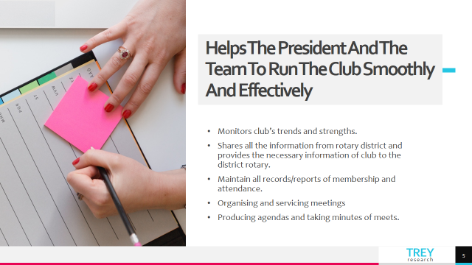

Slide 4


Slide 5
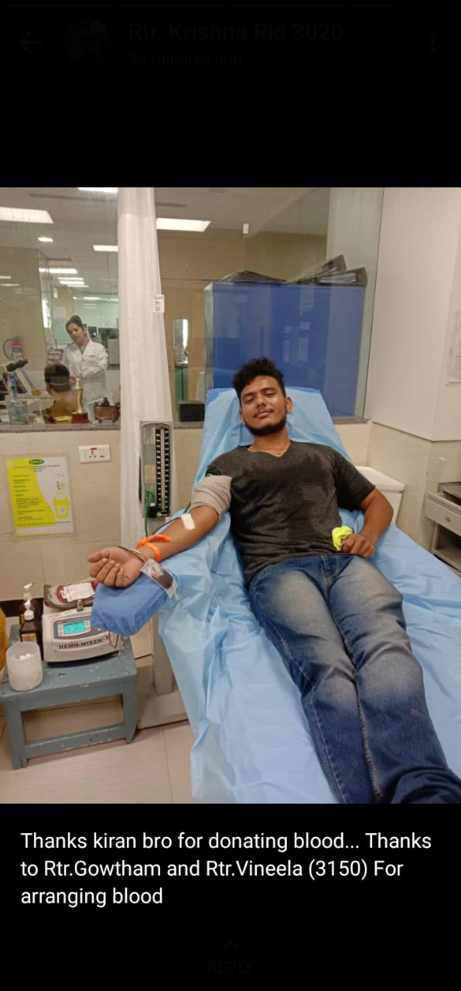


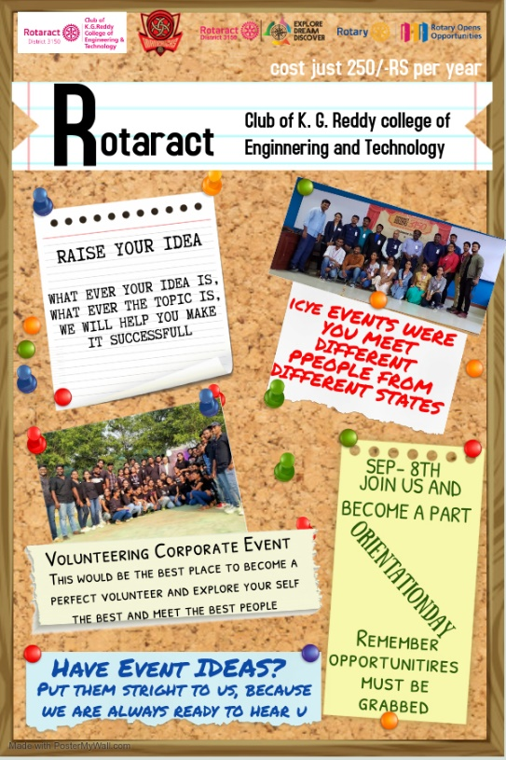
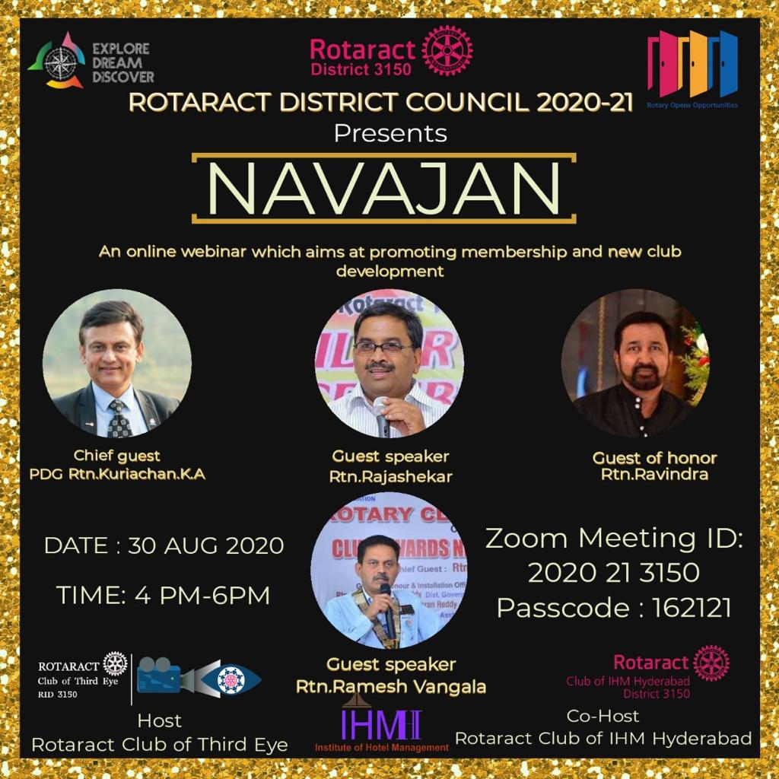
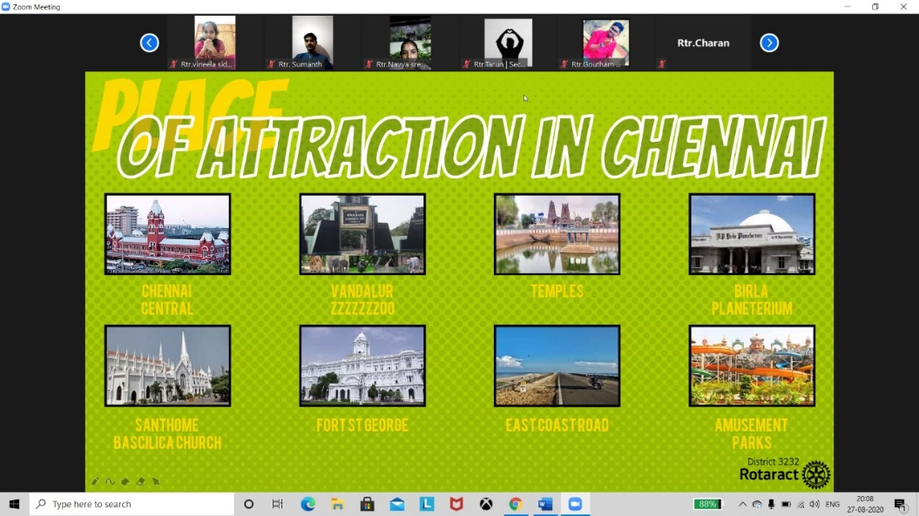


Slide 6
THE ACTIVITIES INCLUDE THE FOLLOWING :
● EMERGEX ● NAVAJAN ● GANESH CHATURTHI OCCASION ● COMMUNITY SERVICES ● TOURS(VIRTUAL) ● ORIENTATION PROGRAMS

Slide 7
MY EXPERIENCES AND AQUAINTANCE THROUGH ROTARACT

Slide 8

WHY ROTARACT ?

Slide 9

Personal Growth
And Development
Interacting with leaders through out the world
Leadership
Development
Opportunities to
Learn new things
Fun And
Entertainment
Traveling opportunities
Social services

Slide 10




Slide 11


Slide 12
ROTARACT CLUB SERVICE
RTR. G. MEGHANA REDDY
CLUB SERVICE DIRECTOR

Slide 13


Agenda
What is Club Service?
Service Activities of Club service Avenue
How can you develop yourself in this Avenue
Year plans of Club service Avenue for the Year 2k21 – 22.

Slide 14
WHAT IS CLUB SERVICE
Club Service focuses on making clubs strong. A thriving club is anchored by strong relationships and an active membership development plan. Club service works to strengthen fellowship of members through generosity and openness. The Rotary Club of Doral has a series of impact initiatives to work toward, so having various social events that bring members and their guests informally and for fun, contributes to genuine fellowship.
The Club Service chair oversees a number of committees in the club that are responsible for such functions as attendance, greeters, club bulletin, fellowship, membership, programs, public relations, remembrances, classifications, Rotary information, technology management, club directory, public relations, finance, and fund development. Club Service is the core of the local club and is dependent on its members to take charge of the various committees.

Slide 15
ACTIVITIES OF CLUB SERVICE AVENUE
The Club Service Officer has an important responsibility, ensuring the weekly meeting program is structured and balanced, that meetings are well run, and that members are kept informed through the Club
The Club Service Officer is responsible for a varied range of activities including:
Weekly meeting program - Rotary months, guest speakers, social and fellowship
Meeting management – Sergeant at arms, Protocol (flags, toast, ethics), induction, new member approval, RI protocol, guests
Keeping members informed – use of information sources including the bulletin, website and Rotary information
Other Club activities – Conference chair, historian, club property, photographer, welfare officer.

Slide 16
HOW CAN ONE DEVELOP THEMSELVES IN CLUB SERVICE AVENUE
FRIENDSHIP
FUN
PUBLIC SPEAKING SKILL
ENTERTAINMENT
THE OPPORTUNITY TO SERVE

Slide 17
YEAR PLAN OF CLUB SERVICE AVENUE
1.Charter day celebration 2.Celebrate member's birthday 3.Fellowship games(treasure Hunt) 4.Leadership development workshop 5.join meeting with other rotaract clubs 6.What you don't know about me 7.visiting an orphanage or oldage home 8.Regular publishing of monthly bulletin 9.Remodelling of animals shelter 10.art and artist contest 11.session on importance of voting 12.rakhi festival 13.University in diversity 14.indoor plants distribution 15.club outing

Slide 18
ROTARACT COMMUNITY SERVICE

Slide 19
WHAT IS COMMUNITY SERVICE
The community service encourages Rotaractors to offer service to their communities. Every Rotaractor assumes a responsibility to find ways to improve the quality of life for those in their communities.
It enhances knowledge and understanding of community needs, problems and opportunities.
It’s our Responsibility to formulate and develop activities for serving the Community.

Slide 20
EXAMPLES OF EVENT IDEAS
Fundraiser events such as dance parties, momo competition, charity shows.
Community service events such as Blood Donations.
Donations to charitable foundations.
Road and Traffic service such as reflectors on dividers.

Slide 21
ROTARACT PROFESSIONAL SERVICE
RTR. DUSA SHIVATEJA
PROFESSIONAL SERVICE DIRECTOR

Slide 22
WHAT IS PROFESIONAL SERVICE AVENUE
* Professional service is an avenue where a Rotaract Club
has to emphasis on a professional growth of the entire team.
* Conducting Seminars, Orientations, Skill Development test are
the key factors to encourage Rotaractors to stable up in the
personal lives.
* The main aim of Professional Service is to benefit its members
to outcast themselves and become leaders tomorrow.

Slide 23
ACTIVITIES OF PROFESSIONAL SERVICE AVENUE
Development, Conducting Aptitude Test for the Members
Seminars for schools students
Team organizing District Assembly & Conference
Organizing Vocational Courses.

Slide 24
HOW CAN ONE DEVELOP THEMSELVES IN PROFESSIONAL SERVICE AVENUE
Plan programs that give Rotaractors the opportunity to achieve self development, eg. Job or hobby talks, participation in specific leadership training activities.

Slide 25
YEAR PLAN OF PROFESSIONAL SERVICE AVENUE
* Technical updates page in our magazine.
* Online Group Discussions on a topic.
* Professional advises from professionals to have proper linkedin profiles and etc.
* Having session on a goal setting techniques.
* Getting online certification courses.
* Tips for making effective presentations.
* Getting hidden talents out of everyone and helping them to improve their skills.

Slide 26
ROTARACT INTERNATIONAL SERVICE
RTR.TARUN KOTAGIRI
INTERNATIONAL SERVICE DIRECTOR

Slide 27
INTERNATIONAL SERVICES
ROTARACT CLUB OF
KGRCET
Tue 17/07
Brand New Bag
USD 3550
Special Price
BUY NOW
Let’s get started
RID 3150
@
poco

Slide 28


Agenda
What is International Service?
Service Activities of International Avenue
How can you develop yourself in this Avenue
Year plans of International Avenue for the Year 2k21 – 22.

Slide 29
Introduction
The International Service Avenue aims at creating awareness among the students regarding the international issues and bringing them at par with the conditions prevailing internationally.

Slide 30

WHAT IS INTERNATIONATIONAL SERVICE?

Slide 31
WHAT IS INTERNATIONAL SERVICE
International Service encompasses actions taken to expand Rotary's humanitarian reach around the globe and to promote world understanding and peace.
In this area, Rotarians strive for the advancement of international understanding, goodwill, and peace through a world fellowship of business and professional persons united in the ideal of service.

Slide 32
Activities of international avenue

Slide 33
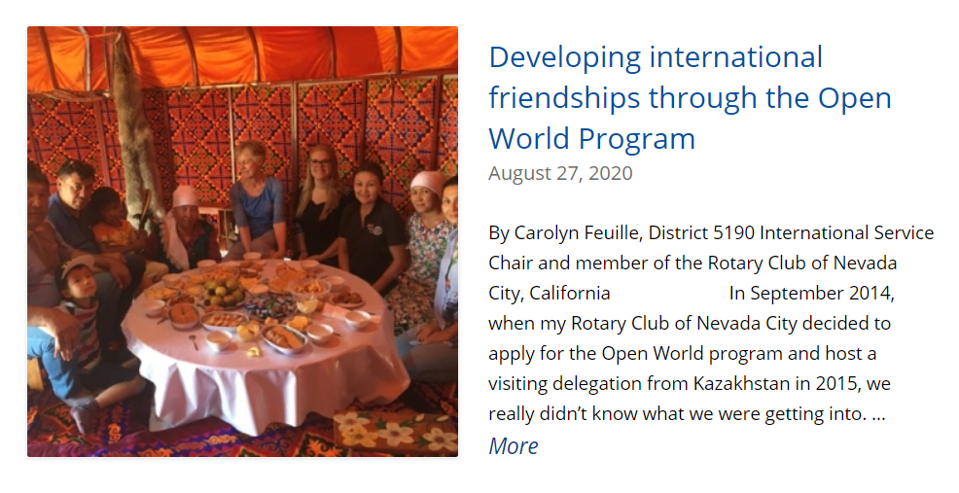

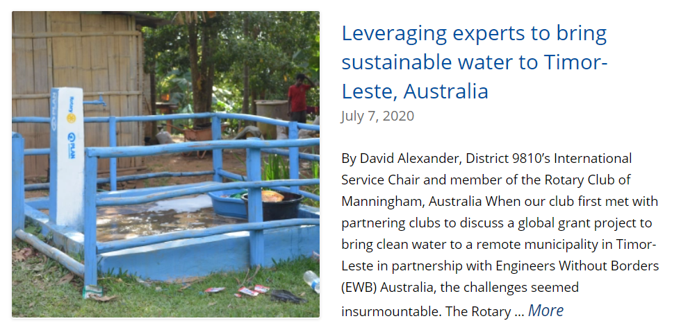

Slide 34

How can you Develop yourself in International Avenue
2021

Slide 35




Build Yourself!
speaking
networking
Team work
Self esteem

Slide 36

YEAR PLANS OF INTERNATIONAL AVENUE

Slide 37
Year Plans
There is no one-way to carry out a International Service project. When it comes to implementing a project, creativity and imagination are the keys to success.
Exchanging Letter Heads.
Youth Exchange Programs.
Collaboration projects with other Districts.
Celebrating World days.
International Cultural Evenings.
Let’s solve as many Community problems as we can this Year forward!

Slide 38

Let’s come up with projects that address priority needs identified by the communities, and let’s help people in helping themselves, and we must also ensure all our projects are environmentally sustainable.

Slide 39
ROTARACT CULTURAL SERVICE
RTR.SONAL SINGH
CULTURAL SERVICE DIRECTOR

Slide 40
WHAT IS CULTURAL SERVICE AVENUE
The Cultural Service Avenue organizes various cultural Activities, making Rotaract a fun place to stick around.

Slide 41


HOW CAN SOMEONE DEVELOP THEMSELVES THROUGH CULTURAL AVENUE?
The cultural club aim is to enhance student potential in the interested field.

Slide 42
CULTURAL CLUB YEAR PLAN :-
ONLINE GAME COMPETITION (BGMI,FREEFIRE,WCC etc.)
CULTURAL DAY
ART COMPETITION(DRAWING,PAINTING)
BLOG WRITING
FLASH MOB
PHOTOGRAPHY COMPETITION
SHORT FILM (DRAMA ETC.)
SINGING
RANGOLI COMPETITION
BATHUKAMMA CELEBRATION/GARBA
SPORTS DAY
ELOCUTION COMPETITION
FESTIVAL CELEBRATION(GANESH CHATURTHI,CHRISTMAS ETC.)

Slide 43
ANY QUESTIONS..?

Slide 44
s

